Slide 1
BUILDING AERODYNAMICS
MODULE 4

Slide 2
LOW RISE BUILDINGS
Low rise building is defined as an enclosed structure less than 50 feet (15 m) in height.
Usually immersed with in atmospheric boundary layer [Where turbulent intensity is high, interference and shelter effects are important but different to quantify]
Non engineered and lack of maintenance
Wind loads on roof are important
Internal pressure are important – especially for dominant openings
Resonant effects are negligible
Must sustain most damages in severe wind storms

Slide 3
PRESSURE DISTRIBUTION ON LOW RISE BUILDINGS
Majority of the houses that are constructed all over the world are low-rise buildings.
These buildings are constructed in different types of terrain and topography with various planforms.
Measurements of the static pressure on low-rise building models in boundary layer wind tunnels provide vital information that can be used to design houses which are safer and more resistant to adverse weather conditions such as cyclones and hurricanes.

Slide 5
The values of static pressure are converted to non-dimensional pressure coefficient, Cp, which is defined as
Where,
P is the pressure at a given location
P∞ is the free-stream static pressure
U∞ is the free-stream velocity and
ρ is the air density.

Slide 8
The intensity of internal pressure is directly related to the size of dominant openings and their location with respect to the direction of wind angle of attack.
Peak positive internal pressure occurs when a dominant opening of the building faces the incoming wind flow.
➢Peak negative internal pressure occurs when a dominant opening of
the building are in parallel to the incoming wind flow.
➢Dominant openings resulted in an increase internal pressure. For example,
the opening of the window together with ceiling hatch led to 45% increase
on the net wind load on the windward side of the gable roof and 20 %
increase for hip roofs. This reinforces the need for keeping doors and
windows covered with shutters during strong storms.
The point pressure measurements are processed with the help of a contour plotting to obtain surface contour plots on an entire surface of the building. The average values of Cp are estimated on all the faces of the gabled roof building models.

Slide 9
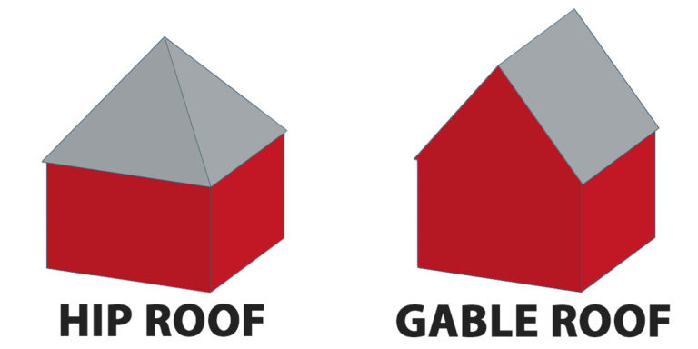

Slide 10
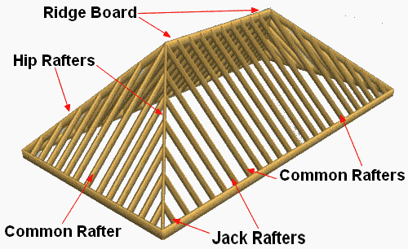

Slide 11

Mean pressure coefficients on pitched roofs
5$°$ roof pitch:
No separation at ridge.
Higher negative pressures for greater h/d.

Slide 12

12$°$ roof pitch:
Second separation at ridge.
Higher negative pressures for greater h/d.

Slide 13

18$°$ roof pitch
Pressure on windward face is less negative at lower h/d

Slide 14

30$°$ roof pitch:
Positive pressure on upwind face of roof for lower h/d.
Uniform negative pressure on downwind roof.

Slide 15

45$°$ roof pitch:
High positive pressure on upwind face of roof at all h/d.
Uniform negative pressure on downwind roof.

Slide 17
The variation of the minimum pressure coefficient over the roof of different building models with the roof pitch angle for any wind direction

Slide 19
At the windward and the leeward portions of the roof, the peak suction over the leeward side is higher compared to that over the windward side with the difference between the two increasing with an increase in the roof pitch.
It is clear from this figure that the worst suction reduces continuously when the roof pitch is increased.
Interesting observations are made for the 45◦ pitch building models.
The minimum Cp value is positive for both the gabled and the hip roof models.
It is also interesting to note that there is a slight increase in the suction on the leeward side for the gabled roof compared to the 30◦ case.

Slide 20
Multi-span buildings

Slide 21
Saw-tooth roofs - magnitude of negative pressures reduces downwind:

Slide 22

WIND FORCES ON BUILDINGS
Forces are classified as static and dynamic. Static loads are independent from time but dynamic loads are function of time. Usually, wind loads are dynamic loads. The design of buildings must account for wind loads, and these are affected by wind shear. For engineering purposes, a power law wind speed profile may be defined as follows:
$V_{z }$= $V_{g}$ ${\left(\frac{Z}{Z_{g}}\right)}^{\frac{1}{α}}$
Where,
Vz = speed of the wind at height;
Vg = gradient wind at gradient height
α= exponential coefficient

Slide 25
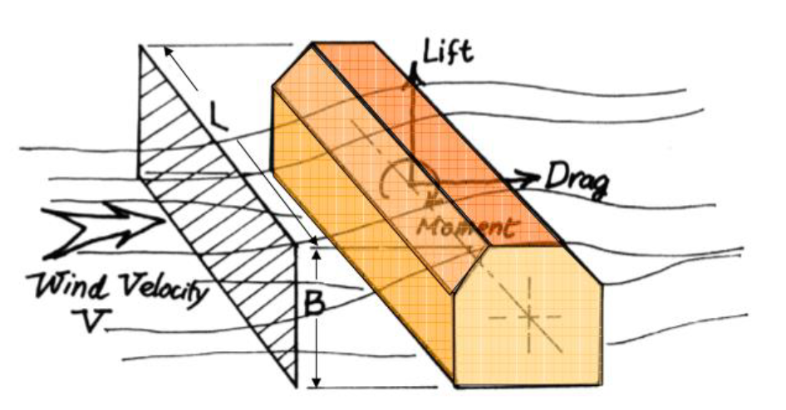

Slide 27
Wind load induced oscillation
There are three forms of wind load induced motion as follows:-
a) Galloping - Galloping is transverse oscillations of some structures due to the development of aerodynamic forces which are in phase with the motion. It is characterized by the progressively increasing amplitude of transverse vibration with increase of wind speed.
b) Flutter - Flutter is unstable oscillatory motion of a structure due to coupling between aerodynamic force and elastic deformation of the structure. Perhaps the’ most common form is oscillatory motion due to combined bending and torsion. Long span suspension bridge decks or any member of a structure with large values of d/t ( where d is the depth of a structure or structural member parallel to wind stream and t is the least lateral dimension of a member ) are prone to low speed flutter.

Slide 28
c)Ovalling: This walled structures with open ends at one or both ends such as oil storage tanks, and natural draught cooling towers in which the ratio of the diameter of minimum lateral dimension to the wall thickness is of the order of 100 or more, are prone to ovalling oscillations. These oscillations are characterized by periodic radial deformation of the hollow structure.

Slide 29
ENVIRONMENTAL WINDS IN CITY BLOCKS
Survey of wind flow in the urban area, especially within tall building in two terms is very important:
(1) Tall buildings can cause undesirable intensification of wind flow in urban streets and open spaces (square).
(2) On the other hand also have the ability to avoid wind flow in urban spaces.
In both cases, depending on various conditions, wind flow or wind stagnation could be favorable or not favorable. So in the polluted urban environments, increased air flow to prevent stagnation and accumulation of the pollution is very useful while for pedestrian and visitors in open space are undesirable and uncomfortable. Generally buildings depending on how their exposure to wind flow, create dual effects including wind flow is increased or recession.

Slide 30
Flow rate set points with a recession in the wind and the tall buildings can deal with the accumulation of air pollution on residents to stop. Also, despite these points can reduce the adverse environmental wind flow can be exploited. If the distance between buildings is appropriate, the aerodynamic areas of each building to act individually and not interfere of wind flow in these areas, the impact of tall building on wind flow reaches minimum level. But if the distance between buildings is not appropriate the aerodynamic take effect, whatever set is denser and more compact, the behaviors of wind flow and the impact on the speed are required more complex analysis and apparent negative occurs.

Slide 31
Tall buildings effect on the air flow and pollution parameters is not distributed consequently the air pollution in cites are increasing. In addition to obstruction of visibility and confined spaces and also play a key role in changing winds direction. But regarding population growth of cities and land shortages and high prices make them inevitable. Other advantages of the towers can save energy and prevent pollution increases. Therefore, the appropriate principles and standards in height, properly locate them, the scale tall buildings, technical rules in making them, Immunization, Landscaping and creating green space around the towers, how exposure to towers for wind flow, appropriate distance to the other buildings, how to design them in terms of urban landscape must be considered to reduce the negative effects of tall buildings.

Slide 32
In order to remove or reduce the environmental impact, create green spaces in floors and roofs of buildings are helpful to reduce environmental problems which is named environmentally friendly buildings and green architecture.
Today, tall building is a phenomenon that the world particularly large cities are facing. The tall buildings in order to exploit the land with having the negative affects in the environment create new problems including increasing congestion population, environmental pollution, reduce citizen access to fresh air and sunlight. However, regarding to population increasing and land shortage, tall buildings could not be avoided. This paper investigates the relationship of tall buildings with urban air pollution as well as the possible reducing of negative affects of tall building on environmental pollution with respect to geographical position, technical rules, immunization, green space, direct of wind, appropriate distance to other buildings, design in terms of visibility and landscape and urban appearance were reviewed.

Slide 33
The study showed that the tall buildings cause increasing the air pollution in large urban area due to changing in wind and its direction and also congestion of tall buildings as a pollution sources. Therefore some techniques to design the tall building must be considered to reduce the negative affects of the tall buildings on environmental pollution. Unfortunately the lack of the construction roles in term of environmental protection and also control of the rules in construction process causing the environmental pollution particularly air pollution. It is suggested that the re-evaluate of the rules with restricted control can improve the air quality in the large cities and also utilization of green spaces in floors and roofs of buildings as environmentally friendly buildings which are attempt to reduce environmental problems.

Slide 34
SPECIAL PROBLEMS OF TALL BUILDINGS
Wind is a phenomenon of great complexity because of the many flow situations arising from the interaction of wind with structures. Wind is composed of a multitude of eddies of varying sizes and rotational characteristics carried along in a general stream of air moving relative to the earth’s surface. These eddies give wind its gusty or turbulent character. The gustiness of strong winds in the lower levels of the atmosphere largely arises from interaction with surface features. The average wind speed over a time period of the order of ten minutes or more, tends to increase with height, while the gustiness tends to decrease with height. The wind vector at a point may be regarded as the sum of the mean wind vector (static component) and a dynamic, or turbulence, component

Slide 36
A consequence of turbulence is that dynamic loading on a structure depends on the size of eddies. Large eddies, whose dimensions are comparable with the structure, give rise to well correlated pressures as they envelop the structure. On the other hand, small eddies result in pressures on various parts of a structure that become practically uncorrelated with distance of separation. Eddies generated around a typical structure are shown in Fig.

Slide 37
Some structures, particularly those that are tall or slender, respond dynamically to the effects of wind. The best known structural collapse due to wind was the Tacoma Narrows Bridge which occurred in 1940 at a wind speed of only about 19 m/s. It failed after it had developed a coupled torsional and flexural mode of oscillation. There are several different phenomena giving rise to dynamic response of structures in wind. These include buffeting, vortex shedding, galloping and flutter. Slender structures are likely to be sensitive to dynamic response in line with the wind direction as a consequence of turbulence buffeting. Transverse or cross-wind response is more likely to arise from vortex shedding or galloping but may also result from excitation by turbulence buffeting. Flutter is a coupled motion, often being a combination of bending and torsion, and can result in instability. For building structures flutter and galloping are generally not an issue.

Slide 38
An important problem associated with wind- induced motion of buildings is concerned with human response to vibration and perception of motion. At this point it will suffice to note that humans are surprisingly sensitive to vibration to the extent that motions may feel uncomfortable even if they correspond to relatively low levels of stress and strain. Therefore, for most tall buildings serviceability considerations govern the design and not strength issues.
Vortex Shedding: The most common source of crosswind excitation is that associated with ‘vortex shedding’. Tall buildings are bluff (as opposed to streamlined) bodies that cause the flow to separate from the surface of the structure, rather than follow the body contour. For a particular structure, the shed vortices have a dominant periodicity that is defined by the Strouhal number. Hence, the structure is subjected to a periodic cross pressure loading, which results in an alternating crosswind force. If the natural frequency of the structure coincides with the shedding frequency of the vortices, large amplitude displacement response may occur and this is often referred to as the critical velocity effect.

Slide 39
The asymmetric pressure distribution, created by the vortices around the cross section, results in an alternating transverse force as these vortices are shed. If the structure is flexible, oscillation will occur transverse to the wind and the conditions for resonance would exist if the vortex shedding frequency coincides with the natural frequency of the structure. This situation can give rise to very large oscillations and possibly failure.
Shedding frequency N is given by
Where,
S = Strouhal number
U = wind speed
b = building width

Slide 40
Pressure coefficients on high- rise buildings

Slide 41
BUILDING CODES
➢ Building codes are set of rules and regulation, provisions that must be observed in the design, construction and maintenance of buildings.
➢ Purpose is to ensure that in a disaster:
o Lives are protected.
o Physical damage is limited.
o Structures critical to human welfare remain operational.
➢ Embody accumulated knowledge of leading scientists, engineers and building construction experts that will produce structures that are ‘Fit for purpose’.
➢ Provide the first line of defence against damage from natural hazards and help ensure public safety.
➢ Must be updated regularly to include new technological developments as well as new information after a disaster.

Slide 42
o New Florida code after hurricane Andrew would have saved 60% of damage if available prior.
o Buildings use 40% of a country's energy, so retrofitting older buildings for safety and energy use is critical.
➢ Building codes are generally intended to be applied by architects and engineers although this is not the case in the UK where Building Control Surveyors act as verifiers both in the public and private sector (Approved Inspectors), but are also used for various purposes by safety inspectors, environmental scientists, real estate developers, contractors and subcontractors, manufacturers of building products and materials, insurance companies, facility managers, tenants, and others.
➢ There are often additional codes or sections of the same building code that have more specific requirements that apply to dwellings and special construction objects such as canopies, signs, pedestrian walkways, parking lots, and radio and television antennas.

Slide 43
Importance of Building Codes
➢ Building codes save lives
➢ Building codes protect your investment
➢ Building codes save on insurance
➢ Building codes increase disaster resilience
➢ Building codes enhances building stock

Slide 44
BUILDING VENTILATION AERODYNAMICS
Ventilating is the process of "changing" or replacing air in any space to provide high indoor air quality (i.e. to control temperature, replenish oxygen, or remove moisture, odors, smoke, heat, dust, airborne bacteria, and carbon dioxide). Ventilation is used to remove unpleasant smells and excessive moisture, introduce outside air, to keep interior building air circulating, and to prevent stagnation of the interior air.
Ventilation includes both the exchange of air to the outside as well as circulation of air within the building. It is one of the most important factors for maintaining acceptable indoor air quality in buildings. Methods for ventilating a building may be divided into mechanical/forced and natural types.

Slide 45
"Mechanical" or "forced" ventilation is used to control indoor air quality. Excess humidity, odors, and contaminants can often be controlled via dilution or replacement with outside air. However, in humid climates much energy is required to remove excess moisture from ventilation air.
Natural ventilation is the ventilation of a building with outside air without the use of a fan or other mechanical system. It can be achieved with openable windows or trickle vents when the spaces to ventilate are small and the architecture permits. In more complex systems warm air in the building can be allowed to rise and flow out upper openings to the outside (stack effect) thus forcing cool outside air to be drawn into the building naturally through openings in the lower areas. These systems use very little energy but care must be taken to ensure the occupants' comfort.

Slide 46
In warm or humid months, in many climates, maintaining thermal comfort solely via natural ventilation may not be possible so conventional air conditioning systems are used as backups. Air-side economizers perform the same function as natural ventilation, but use mechanical systems' fans, ducts, dampers, and control systems to introduce and distribute cool outdoor air when appropriate.

Slide 48
BUILDING ARCHITECTURAL AERODYNAMICS
Architectural aerodynamics gains importance with the effect of rain,snow and fire and their impact on design of buildings and their impact on usage.
In the absence of wind, rain and snow fall vertically downwards. The effect of wind is to give the rain drops and snowflakes a horizontal component of velocity.
There are three consequences of this horizontal movement. The first is on the building where the rain can now impinge on non-horizontal surfaces and so cause staining, or allow mosses and lichens to grow, or can cause damp to penetrate the walls to the detriment of its inhabitants. The second effect is on the comfort of people because the rain can penetrate beneath canopies and other protective devices.
The third is a combination of building and people: in the past the materials of which buildings were made could absorb water, and during a storm, the surface of a large building would absorb tons of water, water which would be evaporated by the wind once the rain had stopped.

Slide 49
Canopies are placed over entrance doors to provide local shelter from the rain to people entering or leaving. The basic approach for the containment of fire in a building, as far as the wind engineer is concerned, is that there shall be an internal volume at roof level, called a smoke reservoir, where the smoke from a fire can collect prior to being removed from the building. There are also considerations for false ceilings and escape routes.
The areas of openings in a fire situation should be sufficient to vent the smoke when there is no wind. This specifies the area of the openings which must work under buoyancy forces alone. The purpose of the wind engineer is to ensure that, under no circumstances, shall the wind inhibit this state of affairs. Studies of fire situations are very similar to those for Ventilation with the exception that external flow is never allowed into smoke reservoirs. It is no good claiming that, on average, more air leaves a reservoir than enters it, because the air entering is cold, and when it mixes with the smoke, it will reduce the temperature of the smoke and cause it to lose its buoyancy, causing secondary flows which might bring the smoke into contact with people.

Slide 50
Tower and dome architecture:
Due to the structural efficiency and economic benefit, the hemispherical dome is a common structural geometry shape for large span sports stadium or for storage purposes. The curve shape makes the accurate estimation of the wind pressure fluctuations on a hemispherical dome a difficult task due to the Reynolds number effects. In the past years, there have been reports of collapse of curve shaped storage domes during strong wind. The wind induced structural failure could be attributed to inadequate wind resistant design and/or poor quality construction
Additional complexity arises for curved bodies (e.g. hemisphere and cylinders) because the location of a separation point cannot be identified purely based on the geometry. This leads to a strong dependency on Reynolds number, boundary layer thickness and the turbulence intensity level of the approaching flow.

Slide 51
A reduction in the maximum pressure coefficient is occurred because the rough surface promotes the turbulent boundary layer over the dome and causes earlier separation over the dome. Consequently, the earlier separation over the dome reduced suction at the separation point, but led to more suction overall in the wake and increased drag.

Slide 52
THANK YOU

